Slide 1
CAPSTONE PROJECT · 2026
Micro-Lending Risk
Intelligence System
₹
AI/ML-Based Loan Default Risk Assessment
Presented by: Deesha (2310990067) Group 10 , Semester VII BE-CSE 2023 BATCH
Project: Capstone Project Year: 2026
Technologies
Python
Machine Learning
Scikit-learn
FastAPI
Streamlit
MySQL
Pandas
NumPy
01

Slide 2
FLOW OF PRESENTATION
INTRODUCTION
PROBLEM STATEMENT
PROPOSED SOLUTION
OBJECTIVES
WHY THIS PROJECT IS DIFFFERENT
CODE PIPELINE
TECHNOLOGY STACK
SYSTME ARCHITECTURE
DATA PREPROCESSING PIPELINE
SQL BUSINESS INSIGHTS OUTPUT SCREENS
EDA OUTPUTS AND SUMMARY
FEATURE ENGINEERING
MACHIENE LEARNING PIPELINE
RISK ASSESMENT ENGINE
LENDING DECISION ENGINE
STREAMLIT DASHBOARD UI & OUTPUTS & RESULTS
CONCLUSION RESULTS & FUTURE SCOPE

Slide 3
OVERVIEW
Introduction
Our project uses AI and Machine Learning to check borrower details and predict whether they may have difficulty repaying a loan.
1
It looks at important details like loan amount, income, interest rate, DTI, credit history, employment, and loan purpose to calculate a risk score and risk category.
2
The system gives a clear lending recommendation with reasons, helping lenders make faster and more consistent decisions.
3
MySQL, FastAPI, and Streamlit are used to store data, manage the system, and provide an easy-to-use dashboard, making the overall process simple, fast, and easy to understand.
4
MICRO-LENDING RISK INTELLIGENCE SYSTEM - Presented by: Deesha (2310990067) Group 10 , Semester VII BE-CSE 2023 BATCH

Slide 4
THE CHALLENGE
Problem Statement
1
2
Micro-lenders often rely on manual verification and traditional credit assessment methods, which are time-consuming, prone to human bias, and may lead to inconsistent lending decisions. This makes it difficult to process loan applications quickly while ensuring fairness and accuracy.
With the growing volume of borrower data, identifying hidden risk patterns becomes challenging. Conventional approaches may fail to capture complex relationships in the data and often lack transparency, resulting in inaccurate or uneven risk classification and increased chances of loan defaults.
MICRO-LENDING RISK INTELLIGENCE SYSTEM - Presented by: Deesha (2310990067) Group 10 , Semester VII BE-CSE 2023 BATCH

Slide 5
APPROACH
Proposed Solution
Analyze borrower data using AI/ML to understand their financial and credit profile.
1
Predict loan default probability using a trained Machine Learning model.
2
Calculate risk score and category such as Low, Medium, High, or Very High Risk.
3
Provide a lending recommendation with simple reasons for the decision.
4
Use Streamlit, FastAPI, and MySQL to provide an interactive, reliable, and user-friendly system.
5
MICRO-LENDING RISK INTELLIGENCE SYSTEM - Presented by: Deesha (2310990067) Group 10 , Semester VII BE-CSE 2023 BATCH

Slide 6
GOALS
Objectives
01
02
03
To automate borrower risk assessment by using financial and credit information such as income, loan amount, interest rate, credit score, and debt-to-income ratio.
To predict and classify loan risk by calculating the probability of default and converting it into an easy-to-understand risk score such as Low, Medium, High, or Very High Risk.
To improve lending decisions by providing a clear recommendation (Eligible/Not Eligible) along with the main reasons behind the decision, making the process faster, more consistent, and easier to understand.
MICRO-LENDING RISK INTELLIGENCE SYSTEM - Presented by: Deesha (2310990067) Group 10 , Semester VII BE-CSE 2023 BATCH

Slide 7
Business value
Value to a lender: The platform can reduce manual effort, make screening more consistent and help focus human review on medium- and high-risk applications.
APPROACH
Why This Project Is Different
TRADITIONAL SYSTEM
PROPOSED AI SYSTEM
Borrower Data
Borrower Data
Data Engineering
ML Prediction
Manual Rules
Default Probability
Risk Scoring
Explainable Decision
Loan Decision
Static thresholds. Same treatment for every borrower. No visibility into risk drivers.
Combines machine-learning-based default prediction with an interpretable risk-scoring and lending-decision engine exposed through both API and interactive dashboard interfaces.
MICRO-LENDING RISK INTELLIGENCE SYSTEM - Presented by: Deesha (2310990067) Group 10 , Semester VII BE-CSE 2023 BATCH

Slide 8
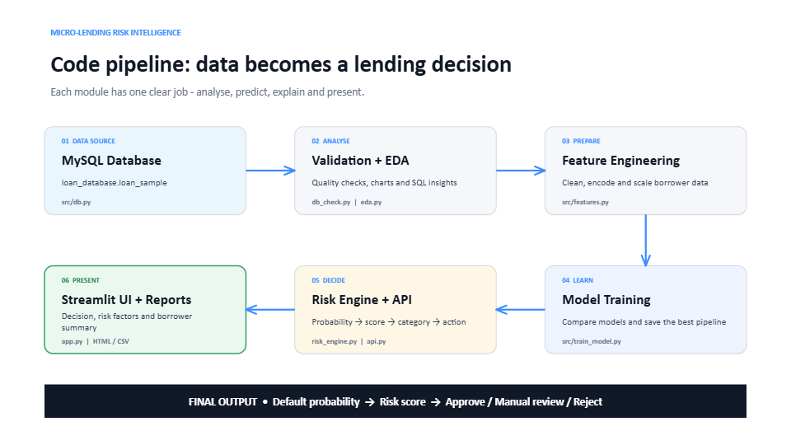
SYSTEM ARCHITECTURE
MICRO-LENDING RISK INTELLIGENCE SYSTEM - Presented by: Deesha (2310990067) Group 10 , Semester VII BE-CSE 2023 BATCH

Slide 9
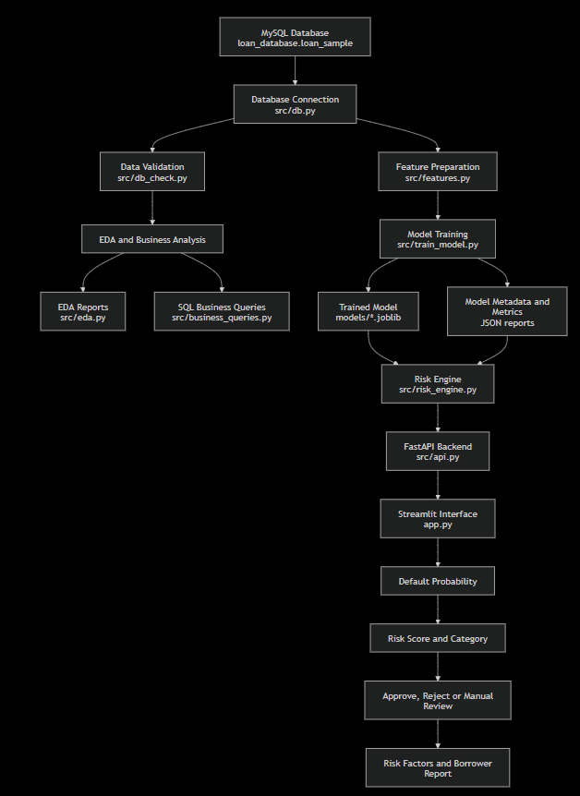
CODE PIPELINE
MICRO-LENDING RISK INTELLIGENCE SYSTEM - Presented by: Deesha (2310990067) Group 10 , Semester VII BE-CSE 2023 BATCH

Slide 10
CODE PIPELINE - Generated commands used
Task | Command
Check database | python3 -m src.db_check
Generate EDA | python3 -m src.eda
Generate business reports | python3 -m src.business_queries
Train model | python3 -m src.train_model
Run Streamlit interface | python3 -m streamlit run app.py
Run FastAPI backend | python3 -m uvicorn src.api:app --reload
MICRO-LENDING RISK INTELLIGENCE SYSTEM - Presented by: Deesha (2310990067) Group 10 , Semester VII BE-CSE 2023 BATCH

Slide 11
STACK
Technology Stack
DATABASE
BACKEND
MACHINE LEARNING
FRONTEND / VISUALIZATION
DEVELOPMENT
MySQL
Python
Scikit-learn
Streamlit
VS Code
FastAPI
NumPy
Matplotlib / Plotly
Python Virtual Env.
Uvicorn
Pandas
Git / GitHub
Joblib
MICRO-LENDING RISK INTELLIGENCE SYSTEM - Presented by: Deesha (2310990067) Group 10 , Semester VII BE-CSE 2023 BATCH

Slide 12
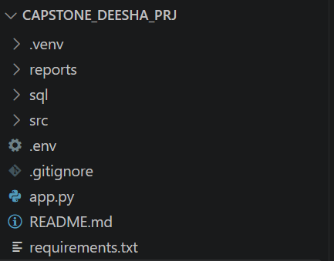
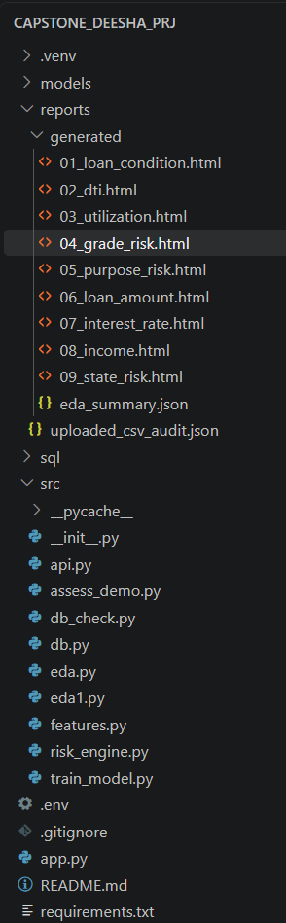
PROJECT LAYOUT
File Structure
CAPSTONE_DEESHA_PRJ
.venv
Python virtual environment
reports / generated
EDA HTML reports & summaries
sql
Database schema & queries
src
Application source code
app.py
Streamlit application entry point
requirements.txt
Project dependencies
MICRO-LENDING RISK INTELLIGENCE SYSTEM - Presented by: Deesha (2310990067) Group 10 , Semester VII BE-CSE 2023 BATCH

Slide 13
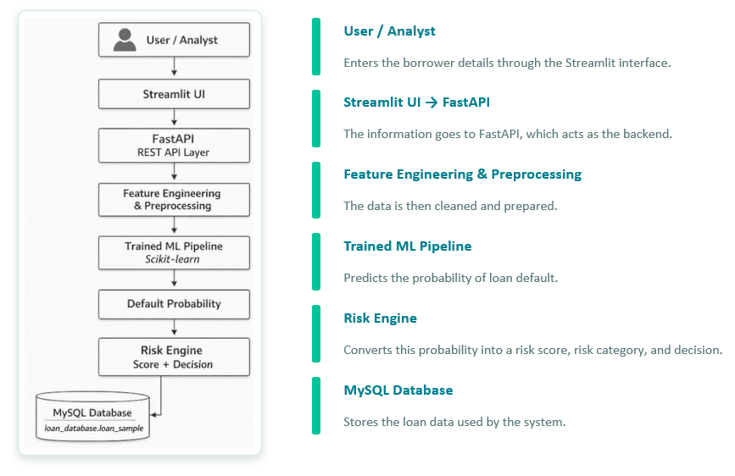
SYSTEM ARCHITECTURE
First, the user enters the borrower details through the Streamlit interface. The information goes to FastAPI, which acts as the backend. The data is then cleaned and prepared through feature engineering and preprocessing. After that, the trained machine-learning model predicts the probability of loan default. The risk engine converts this probability into a risk score, risk category, and decision. The MySQL database stores the loan data used by the system.
MICRO-LENDING RISK INTELLIGENCE SYSTEM - Presented by: Deesha (2310990067) Group 10 , Semester VII BE-CSE 2023 BATCH

Slide 14
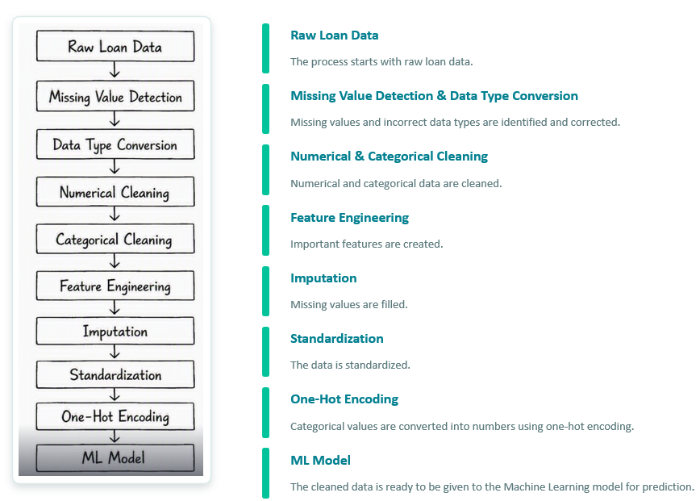
DATA PREPROCESSING PIPELINE
The process starts with raw loan data. First, missing values and incorrect data types are identified and corrected. Then numerical and categorical data are cleaned. Important features are created, missing values are filled, and the data is standardized. Categorical values are converted into numbers using one-hot encoding. Finally, the cleaned data is ready to be given to the Machine Learning model for prediction.
MICRO-LENDING RISK INTELLIGENCE SYSTEM - Presented by: Deesha (2310990067) Group 10 , Semester VII BE-CSE 2023 BATCH

Slide 15
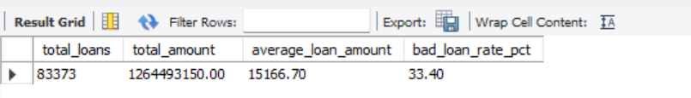
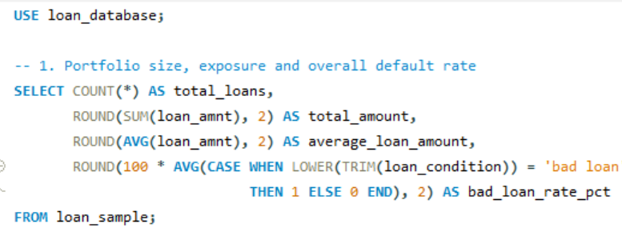
SQL Business Insights Screenshot Output
PORTFOLIO OVERVIEW Calculates total loans, total loan amount, average loan amount and overall bad-loan percentage. It gives management a quick view of portfolio size, exposure and risk.
MICRO-LENDING RISK INTELLIGENCE SYSTEM - Presented by: Deesha (2310990067) Group 10 , Semester VII BE-CSE 2023 BATCH

Slide 16
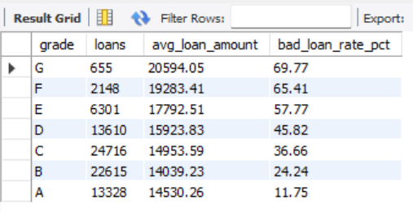
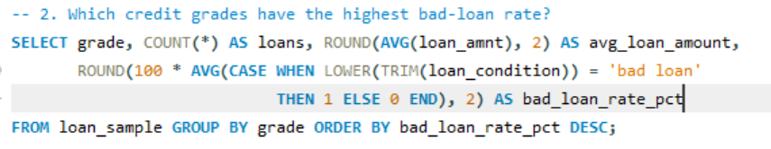
SQL Business Insights Screenshot Output
2. Risk by credit grade | Compares the number of loans, average amount and bad-loan rate for each grade. It helps check whether assigned grades correctly represent increasing credit risk.
MICRO-LENDING RISK INTELLIGENCE SYSTEM - Presented by: Deesha (2310990067) Group 10 , Semester VII BE-CSE 2023 BATCH

Slide 17
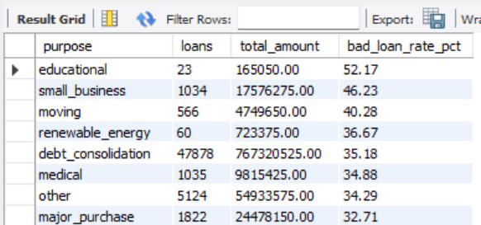
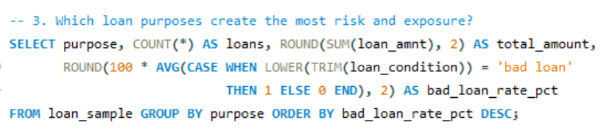
SQL Business Insights Screenshot Output
3. Risk by loan purpose | Shows loan volume, total exposure and bad-loan rate for each purpose. It helps identify high-risk purposes and improve product-level lending rules.
MICRO-LENDING RISK INTELLIGENCE SYSTEM - Presented by: Deesha (2310990067) Group 10 , Semester VII BE-CSE 2023 BATCH

Slide 18
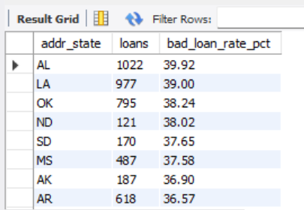
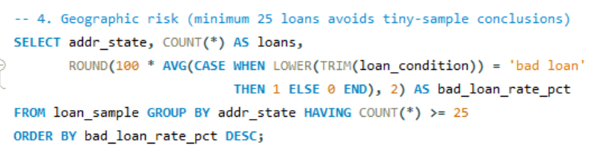
SQL Business Insights Screenshot Output
4. Geographic risk | Calculates bad-loan rates by state while excluding groups with fewer than 25 loans. The minimum count reduces misleading conclusions from very small samples.
MICRO-LENDING RISK INTELLIGENCE SYSTEM - Presented by: Deesha (2310990067) Group 10 , Semester VII BE-CSE 2023 BATCH

Slide 19
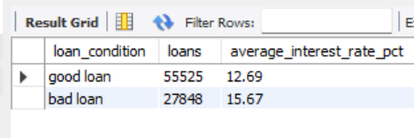
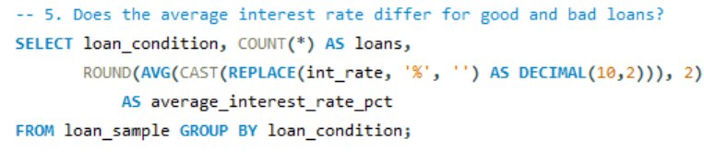
SQL Business Insights Screenshot Output
5. Interest rate by outcome | Compares average interest rates for good and bad loans. It shows whether higher-risk borrowers received higher prices and whether pricing aligns with outcomes.
MICRO-LENDING RISK INTELLIGENCE SYSTEM - Presented by: Deesha (2310990067) Group 10 , Semester VII BE-CSE 2023 BATCH

Slide 20
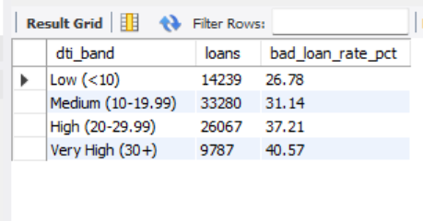
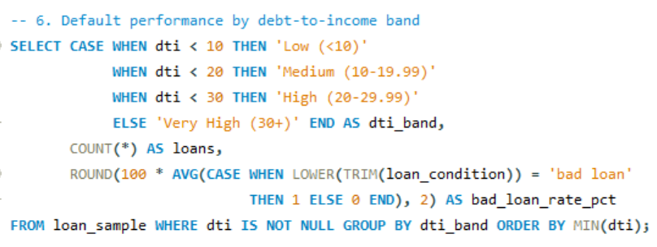
SQL Business Insights Screenshot Output
6. DTI risk bands | Groups borrowers into low, medium, high and very-high DTI bands. It makes the relationship between debt burden and observed default easier to understand.
MICRO-LENDING RISK INTELLIGENCE SYSTEM - Presented by: Deesha (2310990067) Group 10 , Semester VII BE-CSE 2023 BATCH

Slide 21
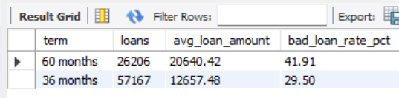
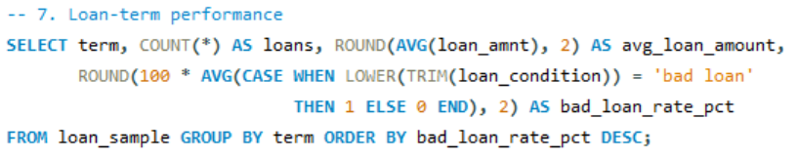
SQL Business Insights Screenshot Output
7. Loan-term performance | Compares loan count, average amount and bad-loan rate across repayment terms. It helps evaluate whether longer terms create higher repayment risk.
MICRO-LENDING RISK INTELLIGENCE SYSTEM - Presented by: Deesha (2310990067) Group 10 , Semester VII BE-CSE 2023 BATCH

Slide 22
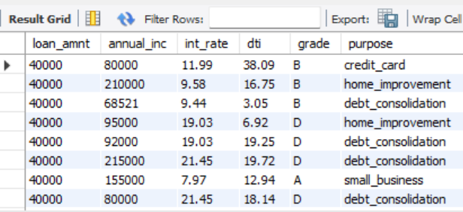
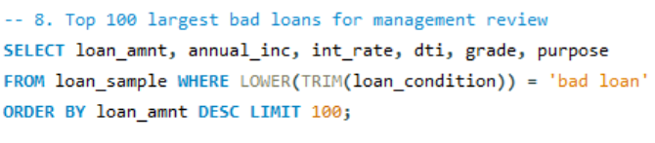
SQL Business Insights Screenshot Output
8. Largest bad loans | Lists the 100 largest bad loans with income, rate, DTI, grade and purpose. It helps managers review the accounts creating the greatest financial exposure.
MICRO-LENDING RISK INTELLIGENCE SYSTEM - Presented by: Deesha (2310990067) Group 10 , Semester VII BE-CSE 2023 BATCH

Slide 23
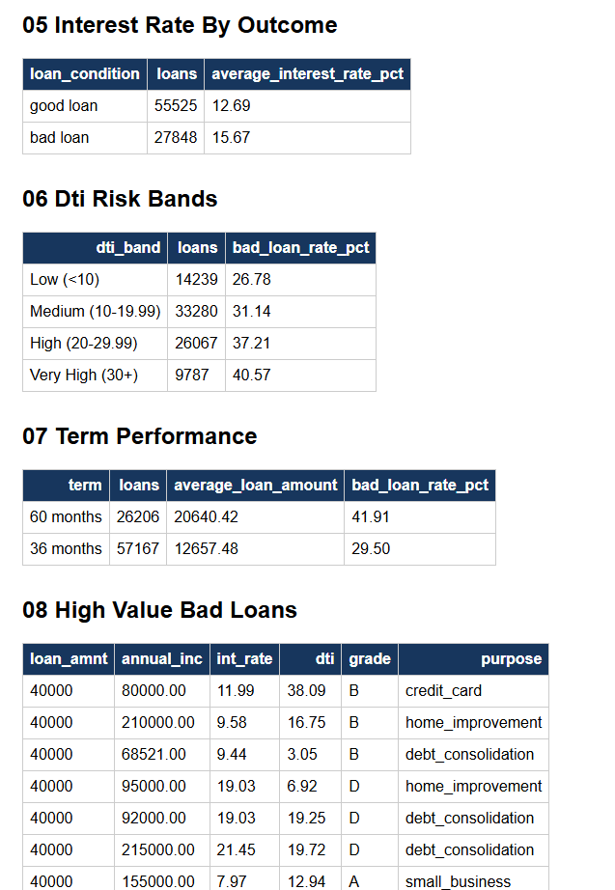
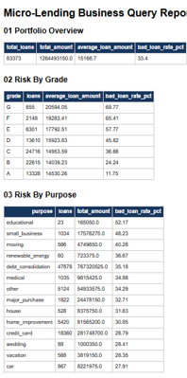
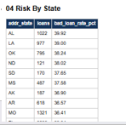
ALL BUSINESS REPORTS OUTPUTS TOGETHER
MICRO-LENDING RISK INTELLIGENCE SYSTEM - Presented by: Deesha (2310990067) Group 10 , Semester VII BE-CSE 2023 BATCH

Slide 24
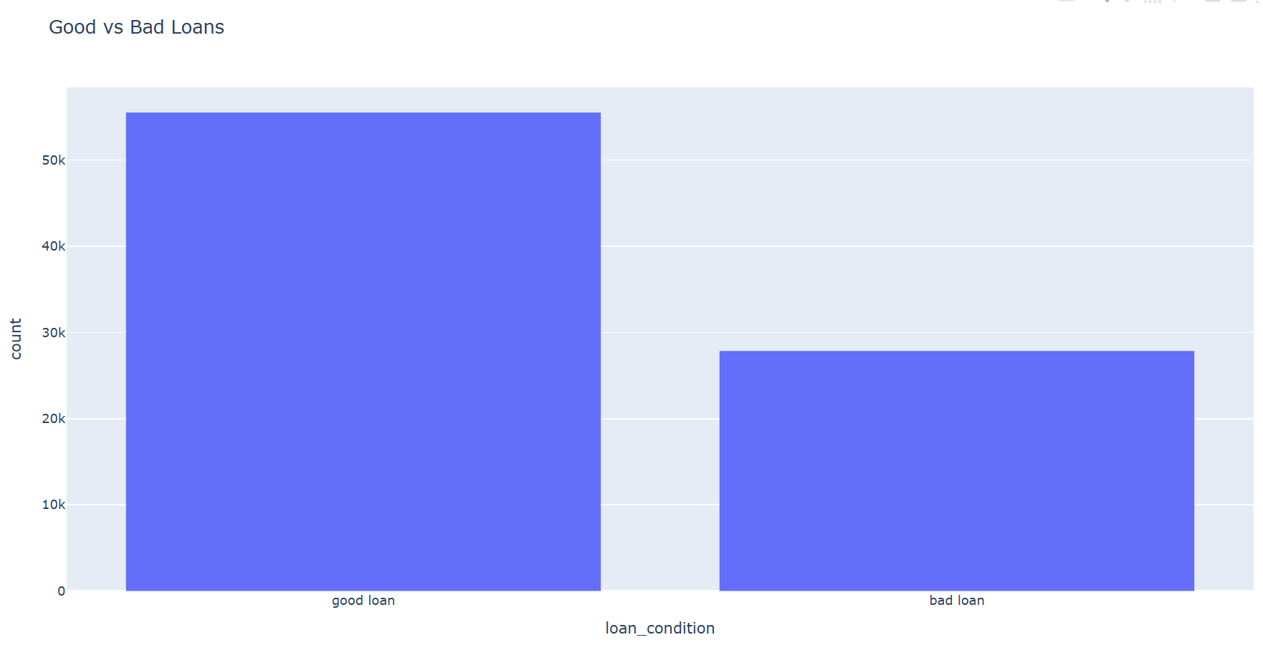
EDA OUTPUTS
1. Good vs Bad Loans | Compares the number of good and bad loans. It helps check class balance and shows whether the model may need special attention to the smaller class.
MICRO-LENDING RISK INTELLIGENCE SYSTEM - Presented by: Deesha (2310990067) Group 10 , Semester VII BE-CSE 2023 BATCH

Slide 25
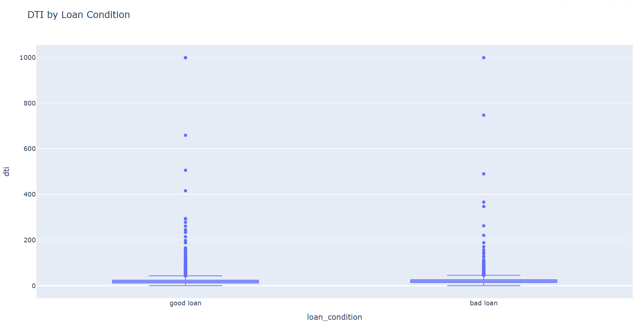
EDA OUTPUTS
2. DTI by Loan Condition | Compares debt-to-income ratios for good and bad loans. A higher DTI can indicate that a larger share of income is already committed to debt.
MICRO-LENDING RISK INTELLIGENCE SYSTEM - Presented by: Deesha (2310990067) Group 10 , Semester VII BE-CSE 2023 BATCH

Slide 26
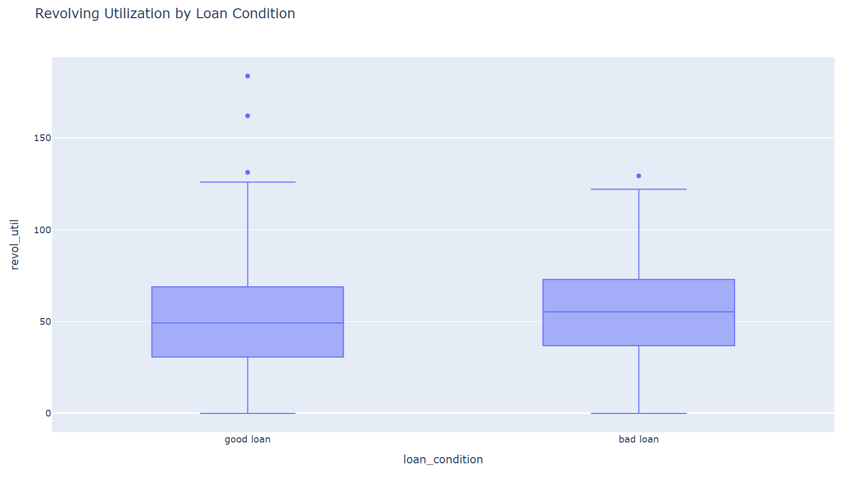
EDA OUTPUTS
3. Revolving Utilization | Compares credit utilization between the two loan outcomes. High utilization may show financial pressure and can be associated with greater repayment risk.

Slide 27
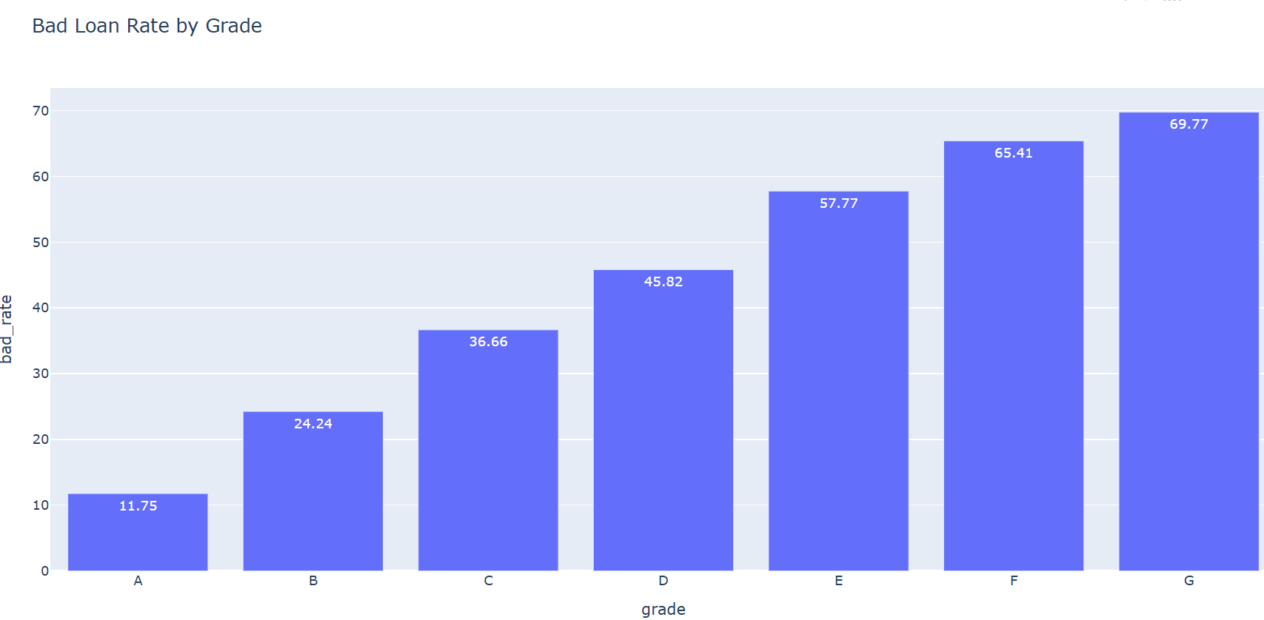
EDA OUTPUTS
4. Bad-Loan Rate by Grade | Shows the default percentage for each credit grade. It helps verify whether weaker grades carry higher observed risk and supports grade-based lending policy.

Slide 28
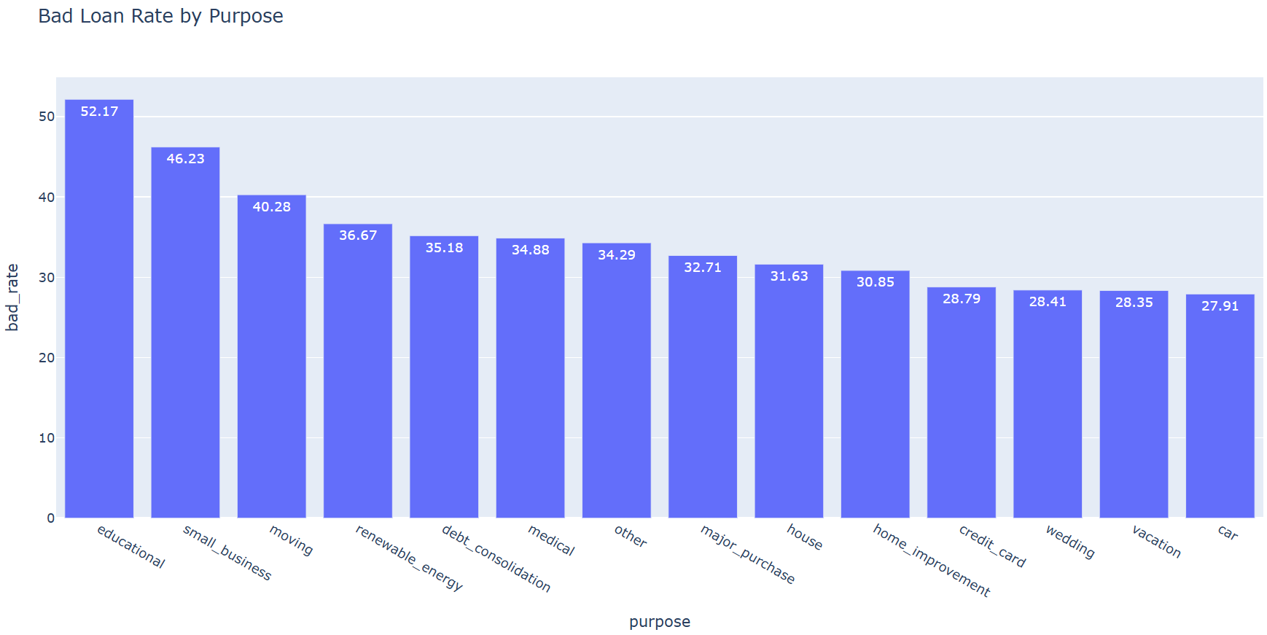
EDA OUTPUTS
5. Bad-Loan Rate by Purpose | Compares default risk across loan purposes such as debt consolidation, business and credit card. It helps identify purposes that may need tighter review.

Slide 29
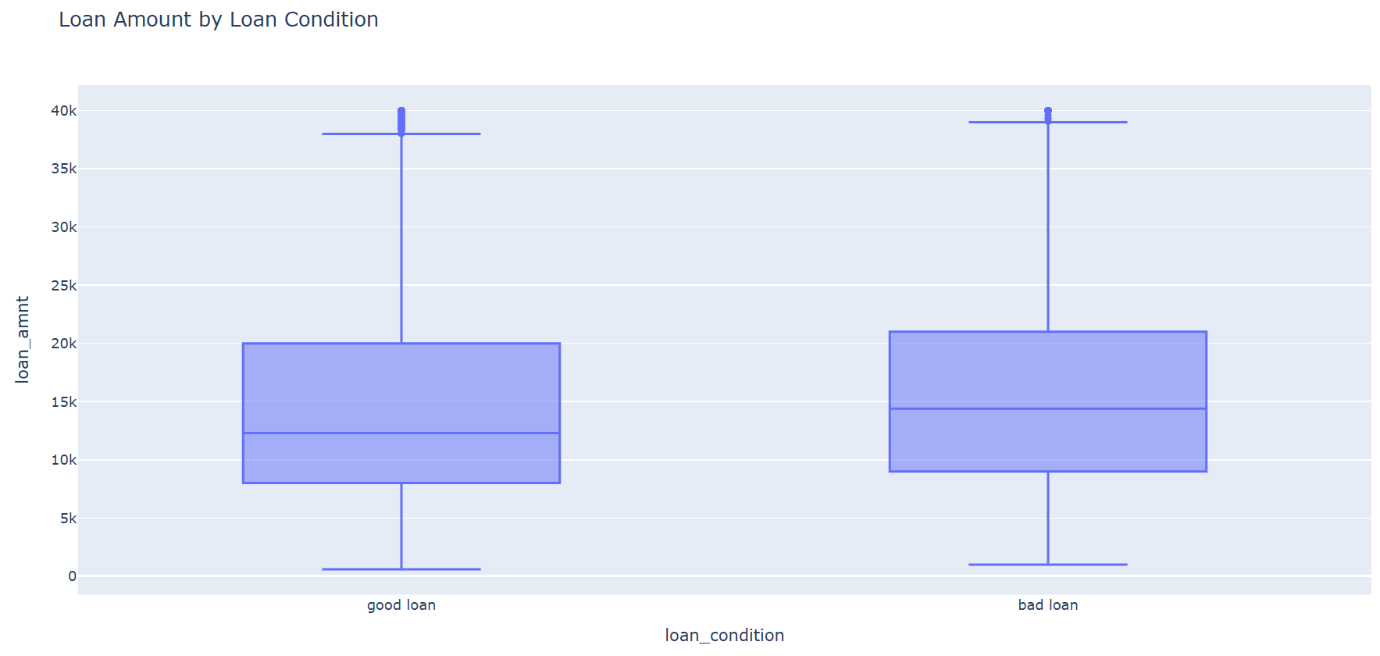
EDA OUTPUTS
6. Loan Amount by Condition | Compares requested loan amounts for good and bad loans. It helps determine whether larger loans are linked with different repayment outcomes or exposure.

Slide 30
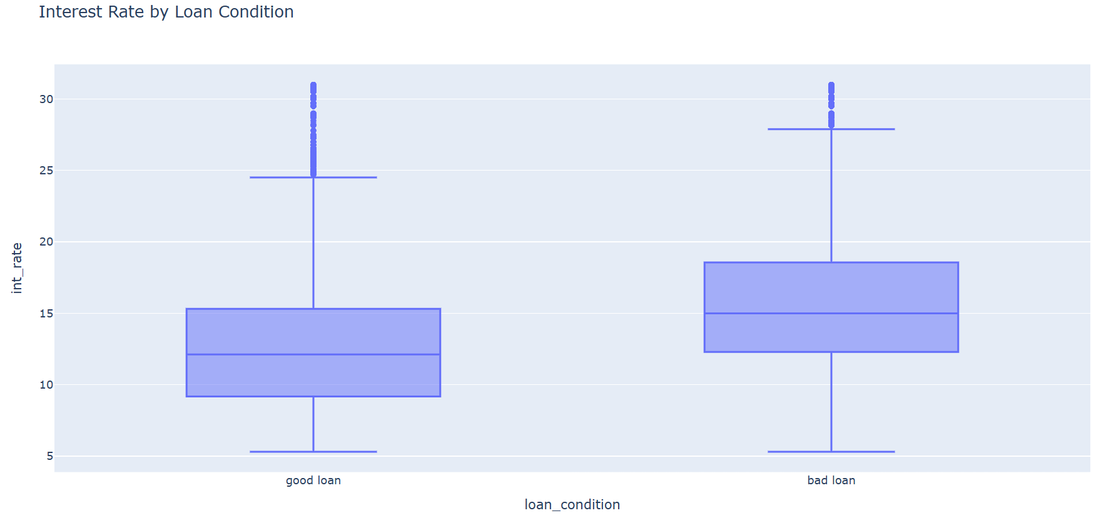
EDA OUTPUTS
7. Interest Rate by Condition | Shows how interest rates differ between good and bad loans. Higher rates often represent higher expected risk, but may also increase repayment burden.

Slide 31
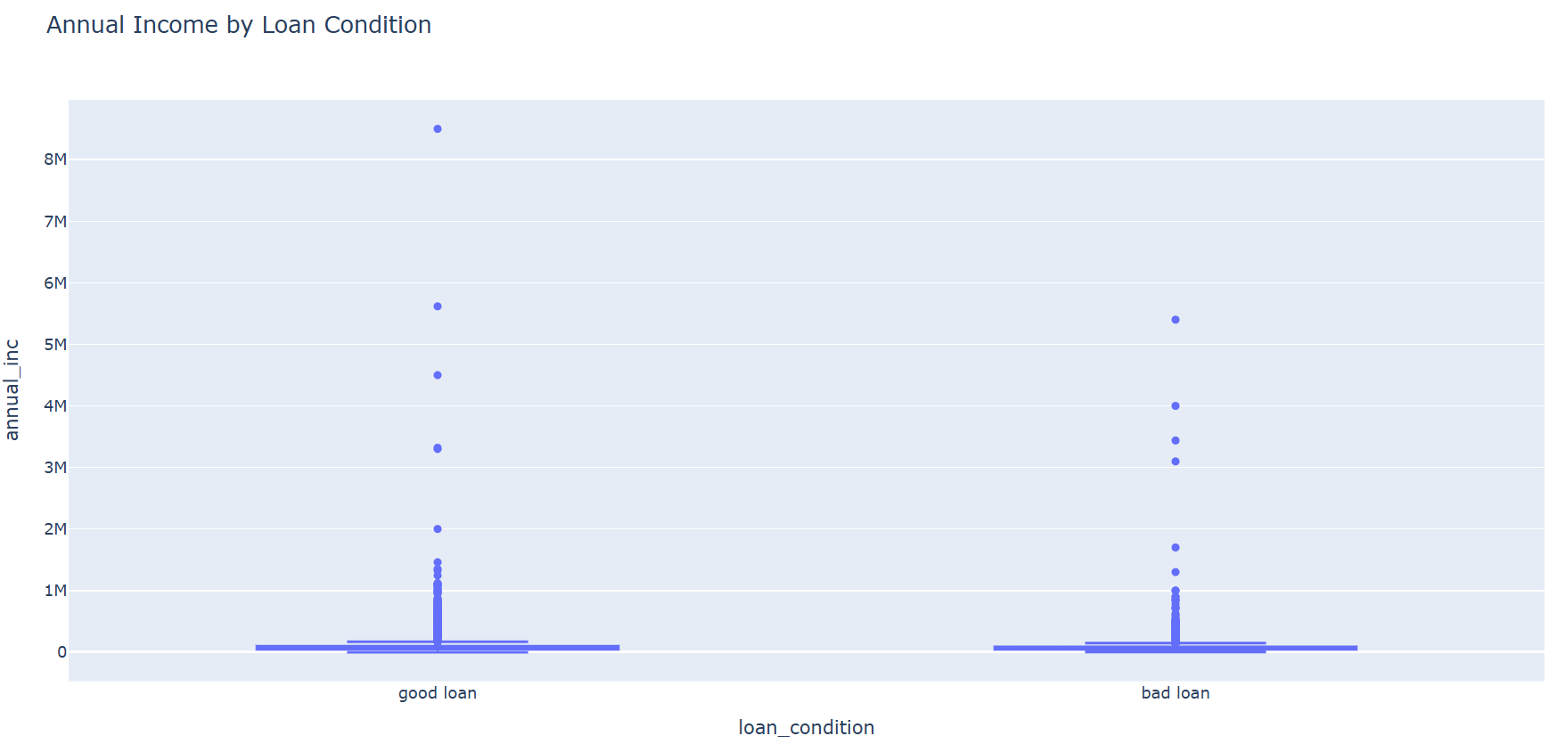
EDA OUTPUTS
8. Annual Income by Condition | Compares borrower income for good and bad loans. Income is useful for judging repayment capacity, but it should be considered together with loan amount and DTI.

Slide 32
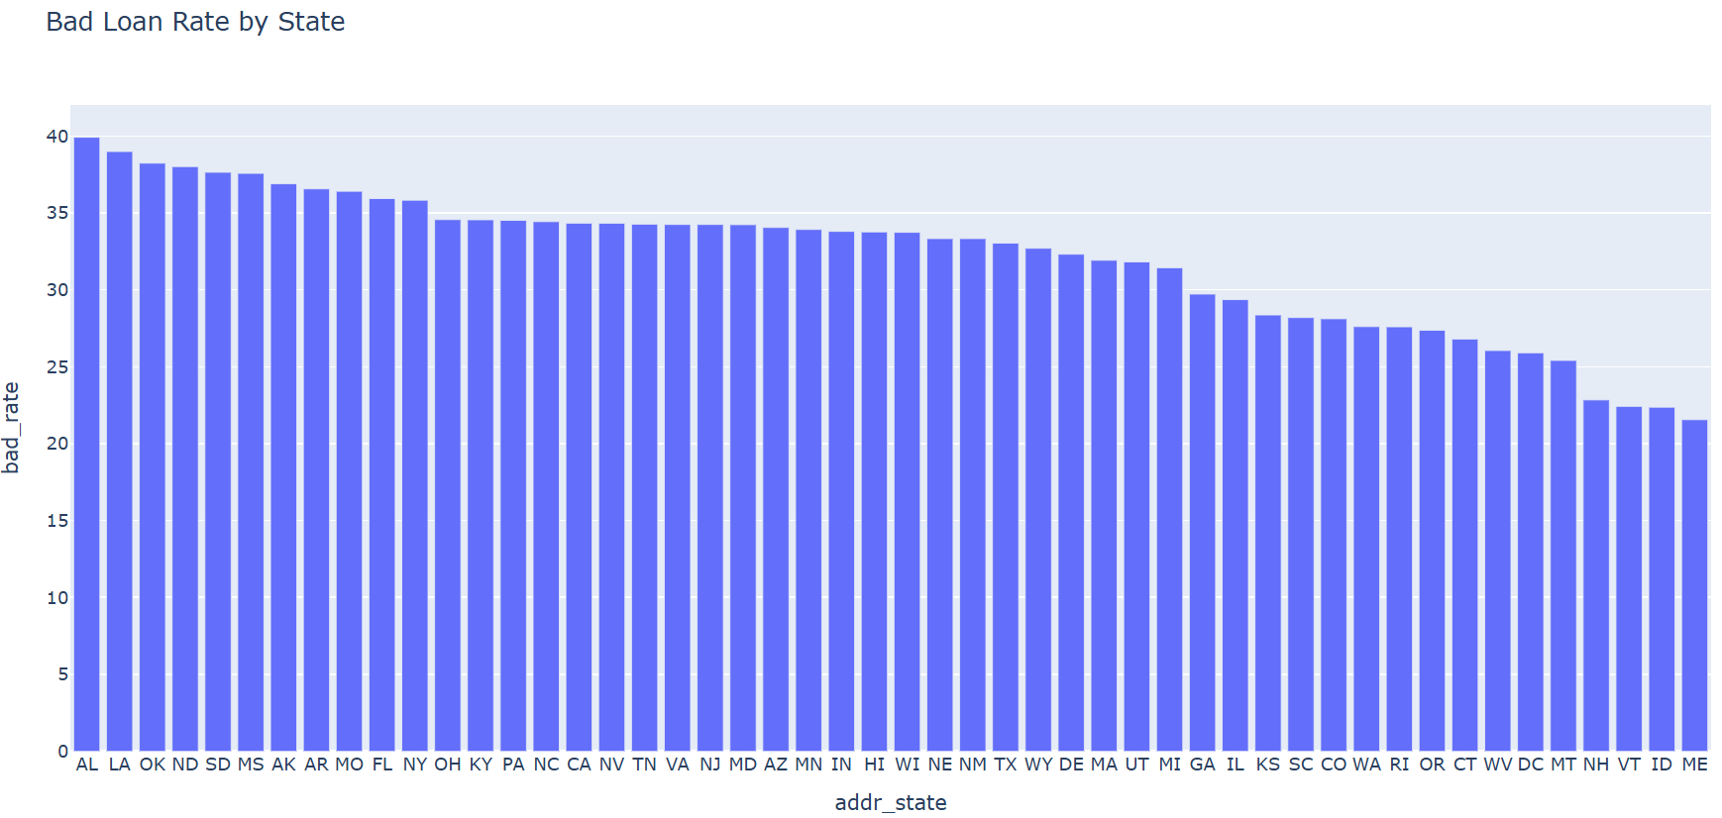
EDA OUTPUTS
9. Bad-Loan Rate by State | Compares default rates across borrower states. It supports geographic monitoring and can reveal areas that require further investigation, not automatic discrimination.

Slide 33
EDA OUTPUTS
EDA SUMMARY
{
"rows": 83373,
"columns_loaded": 10,
"bad_loan_rate_pct": 33.40170079042376,
"avg_loan_amount": 15166.698451537068,
"avg_income": 76586.96949971814
}
MICRO-LENDING RISK INTELLIGENCE SYSTEM - Presented by: Deesha (2310990067) Group 10 , Semester VII BE-CSE 2023 BATCH

Slide 34
Feature Engineering
DATA ENGINEERING
Feature engineering converts raw financial information into variables that are more useful for machine-learning models.
1
Loan-to-Income Ratio
2
Average FICO
Loan-to-Income % = Loan Amount / Annual Income × 100
Average FICO = (FICO Low + FICO High) / 2
Higher values may indicate greater repayment pressure.
3
Credit History
4
Issue Year
Credit History Years = Current Year − Earliest Credit Year
Extracted from the loan issue date.
MICRO-LENDING RISK INTELLIGENCE SYSTEM - Presented by: Deesha (2310990067) Group 10 , Semester VII BE-CSE 2023 BATCH
11

Slide 35
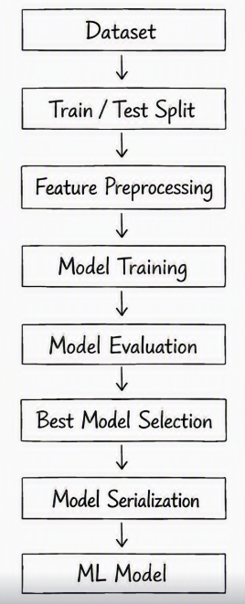
Machine Learning PipelinE Model Development
The trained model is stored as:
models/default_model.joblib
Metadata is stored as:
models/model_metadata.json
Dataset: Collect borrower data containing financial and credit information.
Train/Test Split: Divide the data into training and testing sets.
Feature Preprocessing: Clean and prepare the data for the ML model.
Model Training: Train different machine learning models using the prepared data.
Model Evaluation: Check and compare the performance of the trained models.
Best Model Selection: Select the model that gives the best results.
Model Serialization: Save the selected model for future use.
ML Model: Use the final model to predict the borrower’s loan default risk.
MICRO-LENDING RISK INTELLIGENCE SYSTEM - Presented by: Deesha (2310990067) Group 10 , Semester VII BE-CSE 2023 BATCH

Slide 36
RISK INTELLIGENCE
Risk Assessment Engine
This is where we distinguish the project from a simple ML prediction project.
ML OUTPUT
RISK SCORE
The model produces: Default Probability
The system converts probability into an intuitive score:
For example:
Risk Score = (1 − Default Probability) × 100
Default Probability = 22%
RISK CATEGORIES
WORKED EXAMPLE
75–100
Low Risk
22% default probability
Risk Score = (1 − 0.22) × 100 = 78
55–74
Medium Risk
A default probability of 22% converts to a Risk Score of 78.
35–54
High Risk
<35
Very High Risk
MICRO-LENDING RISK INTELLIGENCE SYSTEM - Presented by: Deesha (2310990067) Group 10 , Semester VII BE-CSE 2023 BATCH
13

Slide 37
RISK INTELLIGENCE
Lending Decision Engine
The system combines the ML result with rule-based risk assessment.
Borrower
POSSIBLE OUTPUTS
ML Model
ELIGIBLE
NOT ELIGIBLE
Default Probability
Risk Score
with reasons such as:
High default probability
High debt-to-income ratio
Low risk score
High credit utilization
Other financial risk indicators
Risk Category
Risk Engine
Decision
MICRO-LENDING RISK INTELLIGENCE SYSTEM - Presented by: Deesha (2310990067) Group 10 , Semester VII BE-CSE 2023 BATCH
14

Slide 38
INTEGRATION
FastAPI REST API
API Endpoints
Endpoint | Purpose
/ | API information
/health | Health check
/model-info | Model details
/predict | Predict new borrower
/borrower/{row_number} | Retrieve borrower
/predict-existing/{row_number} | Assess database borrower
/database-summary | Database statistics
Why an API layer
FastAPI exposes the trained model and risk engine as REST endpoints — so the Streamlit dashboard, or any other client, can request a borrower assessment or database summary programmatically.
MICRO-LENDING RISK INTELLIGENCE SYSTEM
15

Slide 39
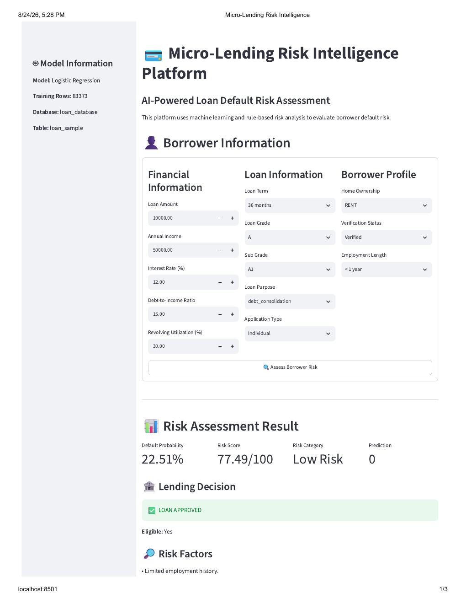
Streamlit Dashboard
Low-risk approval example
In this report, a loan amount of 10,000 and annual income of 50,000 produced a 22.51% default probability and a risk score of 77.49/100. The borrower was classified as Low Risk and the displayed decision was Loan Approved.
MICRO-LENDING RISK INTELLIGENCE SYSTEM - Presented by: Deesha (2310990067) Group 10 , Semester VII BE-CSE 2023 BATCH

Slide 40
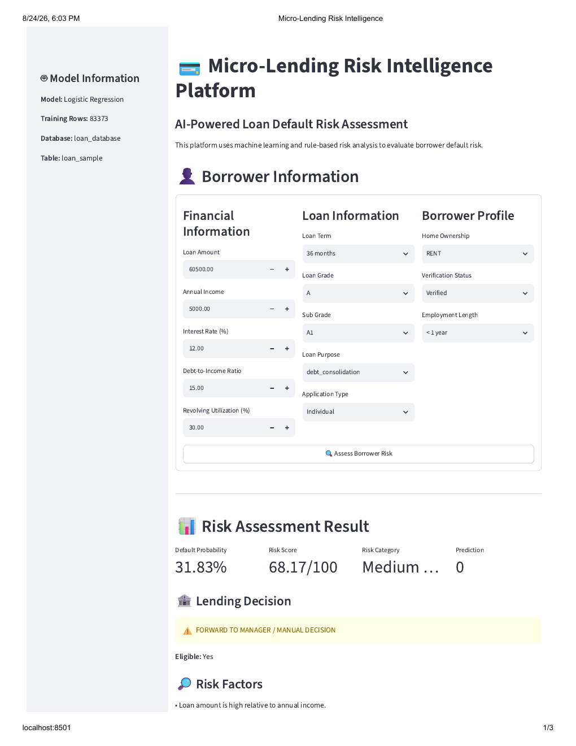
Streamlit Dashboard
Medium-risk manual-review example
In this report, the loan amount was 60,500 while annual income was 5,000. The system produced a 31.83% default probability, a score of 68.17/100 and a Medium Risk category, so it forwarded the case to a manager for manual decision.
MICRO-LENDING RISK INTELLIGENCE SYSTEM - Presented by: Deesha (2310990067) Group 10 , Semester VII BE-CSE 2023 BATCH

Slide 41
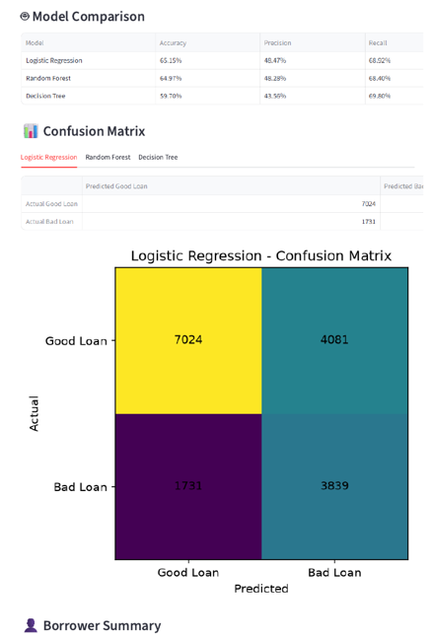
DASHBOARD RESULTS Model Comparison and Confusion Matrix
The comparison table shows that Logistic Regression achieved the best overall result among the displayed models. Its recall of about 68.92% means it detected a useful share of actual bad loans, while its ROC-AUC of about 72.06% shows moderate separation between good and bad borrowers.
The Logistic Regression confusion matrix in the attached UI shows 7,024 correctly predicted good loans, 4,081 good loans predicted as bad, 1,731 bad loans predicted as good, and 3,839 correctly predicted bad loans. The 1,731 missed bad loans are important because they represent risky borrowers that may be approved incorrectly.
MICRO-LENDING RISK INTELLIGENCE SYSTEM - Presented by: Deesha (2310990067) Group 10 , Semester VII BE-CSE 2023 BATCH

Slide 42
Target and selected model
The target column is loan_condition: Good Loan is mapped to 0 and Bad Loan is mapped to 1. Logistic Regression was selected because it gave a useful balance of predictive performance and explainability.
Model | Accuracy | Precision | Recall | ROC-AUC
Logistic Regression | 65.15% | 48.47% | 68.92% | 72.06%
Random Forest | 64.97% | 48.28% | 68.40% | 71.82%
Decision Tree* | 59.70% | 43.56% | 69.80% | Shown in UI comparison
Simple interpretation: Recall is especially important in credit risk because it shows how many actual bad loans were detected. ROC-AUC shows the model’s overall ability to separate good and bad borrowers.
MICRO-LENDING RISK INTELLIGENCE SYSTEM - Presented by: Deesha (2310990067) Group 10 , Semester VII BE-CSE 2023 BATCH

Slide 43
CONCLUSION
Results, Conclusion & Future Scope
RESULTS
The project successfully integrates MySQL + ML + Risk Engine + FastAPI + Streamlit into a single loan-risk intelligence platform.
KEY OUTCOMES
Risk Assessment
Default Prediction
Loan Recommendation
Dashboard & API
Automatically checks the borrower's risk.
Predicts the chance of loan default.
Suggests suitable lending decisions.
Provides an easy dashboard and API for use.
FUTURE SCOPE
Explainable AI
Fraud & Fairness
Cloud & Recommendations
Show why the loan was approved or rejected.
Detect fraud and reduce unfair decisions.
Run the system online and suggest a suitable loan amount.
Thank you.
MICRO-LENDING RISK INTELLIGENCE SYSTEM - Presented by: Deesha (2310990067) Group 10 , Semester VII BE-CSE 2023 BATCH

